Slide 1
Web Engineering
Introduction to Jquery and Ajax
Lecture 8

Slide 2
What is Jquery?
What is jQuery?
jQuery is a lightweight, "write less, do more", JavaScript library.
The purpose of jQuery is to make it much easier to use JavaScript on your website.
jQuery takes a lot of common tasks that require many lines of JavaScript code to accomplish, and wraps them into methods that you can call with a single line of code.

Slide 3
What is Jquery?
jQuery also simplifies a lot of the complicated things from JavaScript.
The jQuery library contains the following features:
HTML/DOM manipulation
CSS manipulation
HTML event methods
Effects and animations
AJAX
Utilities
Tip: In addition, jQuery has plugins for almost any task out there.

Slide 4
Why jQuery?
There are lots of other JavaScript frameworks out there, but jQuery seems to be the most popular, and also the most extendable. Many of the biggest companies on the Web use jQuery, such as: Google Microsoft IBM Netflix

Slide 5
Adding jQuery to Your Web Pages
There are several ways to start using jQuery on your web site. You can:
Download the jQuery library from jQuery.com
Include jQuery from a CDN, like Google
DOWNLOAD Jquery and embed into your code
<head> <script src="jquery-.11.2.min.js"></script> </head>

Slide 6
jQuery CDN
If you don't want to download and host jQuery yourself, you can include it from a CDN (Content Delivery Network).
Both Google and Microsoft host jQuery.
Google CDN:
<head> <script src="http://ajax.googleapis.com/ajax/libs/jquery/1.11.2/jquery.min.js"></script> </head>
Microsoft CDN:
<head> <script src="http://ajax.aspnetcdn.com/ajax/jQuery/jquery-1.11.2.min.js"></script> </head>

Slide 7
jQuery Syntax
The jQuery syntax is tailor made for selecting HTML elements and performing some action on the element(s).
Basic syntax is: $(selector).action()
A $ sign to define/access jQuery
A (selector) to "query (or find)" HTML elements
A jQuery action() to be performed on the element(s)
Examples:
$(this).hide() - hides the current element.
$("p").hide() - hides all <p> elements.
$(".test").hide() - hides all elements with class="test".
$("#test").hide() - hides the element with id="test".

Slide 8
jQuery Selectors
jQuery selectors allow you to select and manipulate HTML element(s).
jQuery selectors are used to "find" (or select) HTML elements based on their id, classes, types, attributes, values of attributes and much more. It's based on the existing CSS Selectors, and in addition, it has some own custom selectors.
When a user clicks on a button, all <p> elements will be hidden:
Example
$(document).ready(function(){ $("button").click(function(){ $("p").hide(); }); });

Slide 9
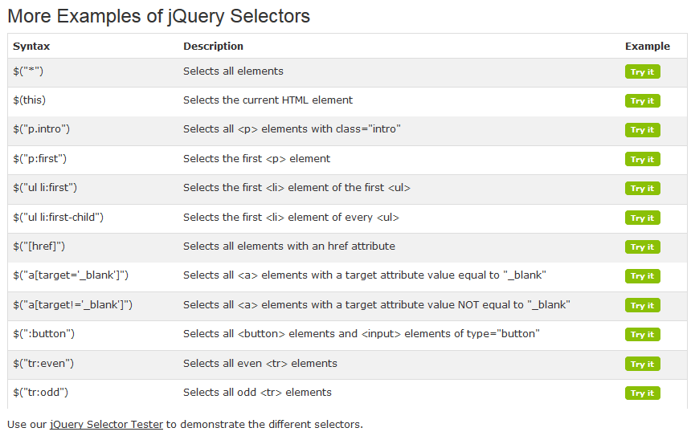

Slide 10
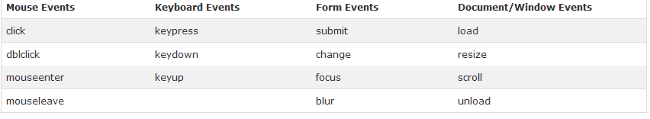
What are Events?
All the different visitor's actions that a web page can respond to are called events. An event represents the precise moment when something happens. Examples: moving a mouse over an element selecting a radio button clicking on an element

Slide 11
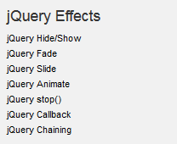
Jquery Effects
jQuery hide() and show()
With jQuery, you can hide and show HTML elements with the hide() and show() methods:
Example
$("#hide").click(function(){ $("p").hide(); }); $("#show").click(function(){ $("p").show(); });

Slide 12
What is Ajax
AJAX stands for Asynchronous JavaScript And XML
Allows web pages or parts of them to be updated asynchronously
Based on XML HTTP request object (AKA XHR)
Requires basic understanding of:
(X)HTML – displaying the data/Dynamic content
CSS – styling the data
JavaScript – manipulating the DOM
XML / JSON – received / sent data format (also HTML & text)

Slide 13
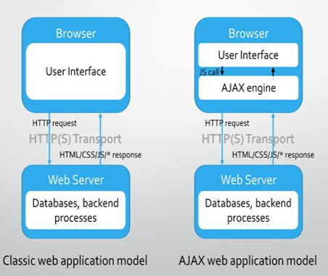
How Ajax Work.

Slide 14
Ajax - Usage samples
Autocomplete search textboxes (sample)
Cascading dropdown list boxes (sample)
Real-time - Continuous data refresh (long polling, chat systems…)
Immediate forms validation feedback (sample)
Conditional display / dynamic content (sample)
Auto save user information (Google Docs, Facebook)
Ratings, voting & other instant actions (sample)

Slide 15
Advantage of Ajax
Better interactivity & responsiveness
Impressive UX
Reduced connections to the web server (partial rendering)
Reduced bandwidth
Its “cool” ☺

Slide 16
Disadvantage of Ajax
The back and refresh button are rendered useless
Bookmarking is useless (HTML 5 History API to the rescue)
Requires JavaScript to be enabled on browsers
SEO & analytics unfriendly
Screen readers unfriendly – affects accessibility
Callbacks can lead to complex code
Network latency may break usability

Slide 17
Making AJAX requests with raw JavaScript
GET or POST?
GET is faster and simpler than POST
Use POST in these cases:
A cached file is not an option (update a file or database on the server)
Sending a large amount of data to the server (POST has no size limitations)
Sending user input (which can contain unknown characters)

Slide 18
Ajax – Send Request
xhttp.open("GET", "ajax_info.txt", true); xhttp.send();
Open - (method, url, async)Specifies the type of request method: - the type of request: GET or POST url: - the server (file) location async: - true (asynchronous) or false (synchronous)send()Sends the request to the server (used for GET)send(string)Sends the request to the server (used for POST)

Slide 19
Get/Post Request
xhttp.open("GET", "demo_get.asp", true); xhttp.send();
xhttp.open("POST", "demo_post.asp", true); xhttp.send();

Slide 20
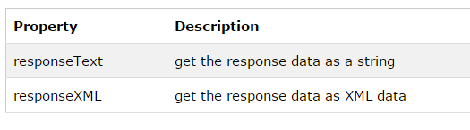
AJAX - Server Response
To get the response from a server, use the responseText or responseXML property of the XMLHttpRequest object.
document.getElementById("demo").innerHTML = xhttp.responseText;

Slide 21
Response in XML form
xmlDoc = xhttp.responseXML; txt = ""; x = xmlDoc.getElementsByTagName("ARTIST"); for (i = 0; i < x.length; i++) { txt += x[i].childNodes[0].nodeValue + "<br>"; } document.getElementById("demo").innerHTML = txt;
Try it yourself »

